Slide 1

Spotify- Trend and Sentiment Analysis with Recommendation System
By:
Rajendran Karthick Sharan

Slide 2
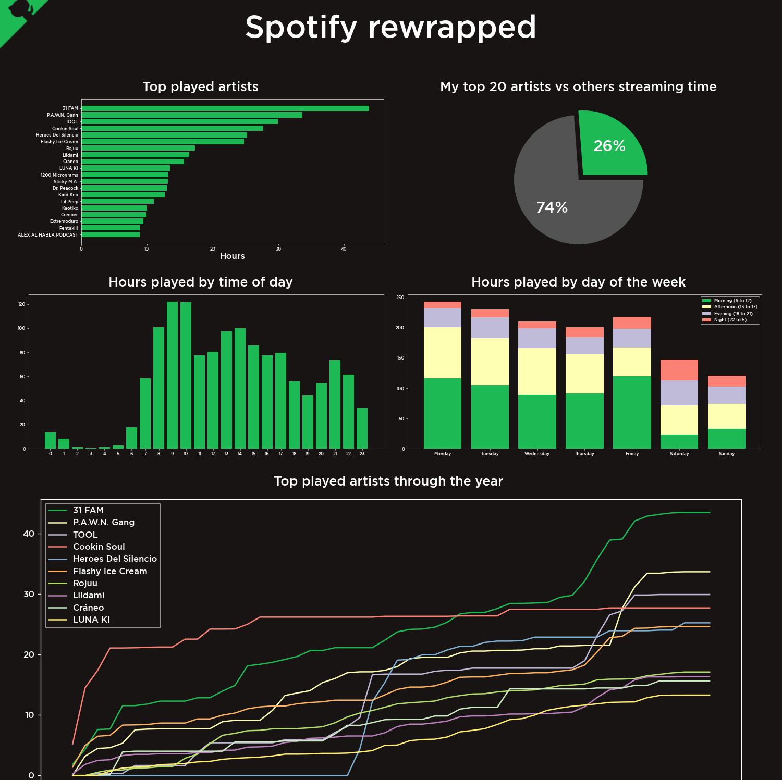
Motivation and Project Overview
With 320 million monthly users and 4 billion playlists, Spotify is one of the most popular music and content streaming platforms in existence.
Much of Spotify’s success has been fueled by data and analytics.
By collecting and analyzing massive amounts of listener data, Spotify can identify emerging user trends in real-time and rapidly develop new features or services to capitalize on them.
This will help Spotify gain an edge over other Music streaming companies and cement its place as a Market leader in the Music/Content Industry.

Slide 3
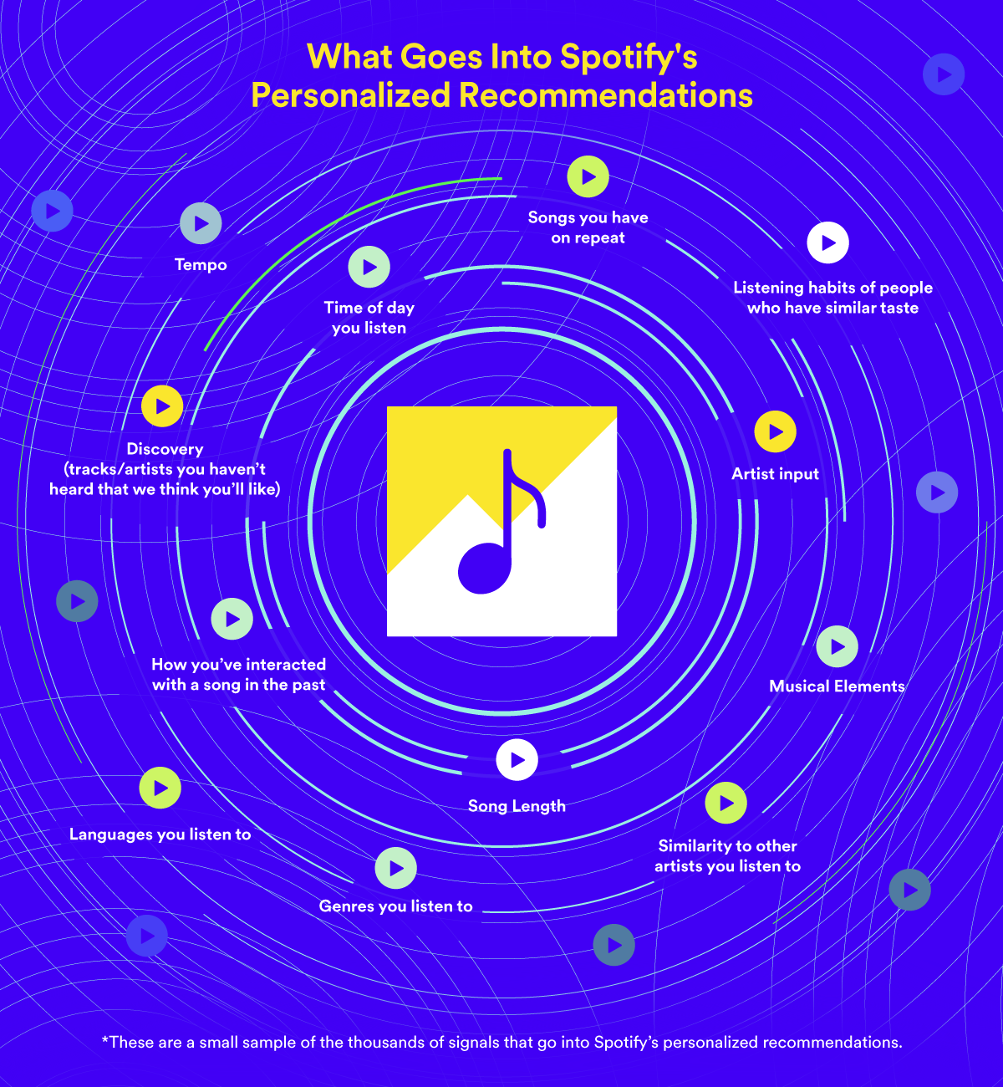
Motivation and Project Overview
The scope of this project is to develop a Machine Learning Model to analyze, identify, and predict the trends/sentiments behind the lyrics and attributes of a track to improve personalization and generate more accurate suggestion algorithms for customers.
Additionally, we’ll identify if having certain sentiments and attributes gives a song an edge over different tracks
Finally, we have developed a recommendation system which suggest songs closest to the mood/sentiment conveyed by a particular track.

Slide 4

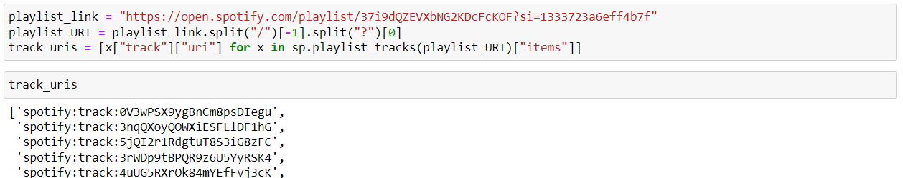
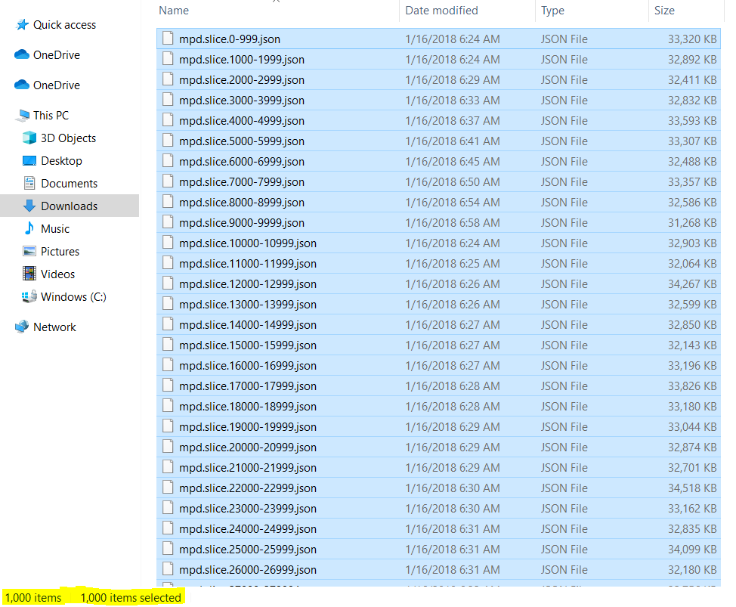
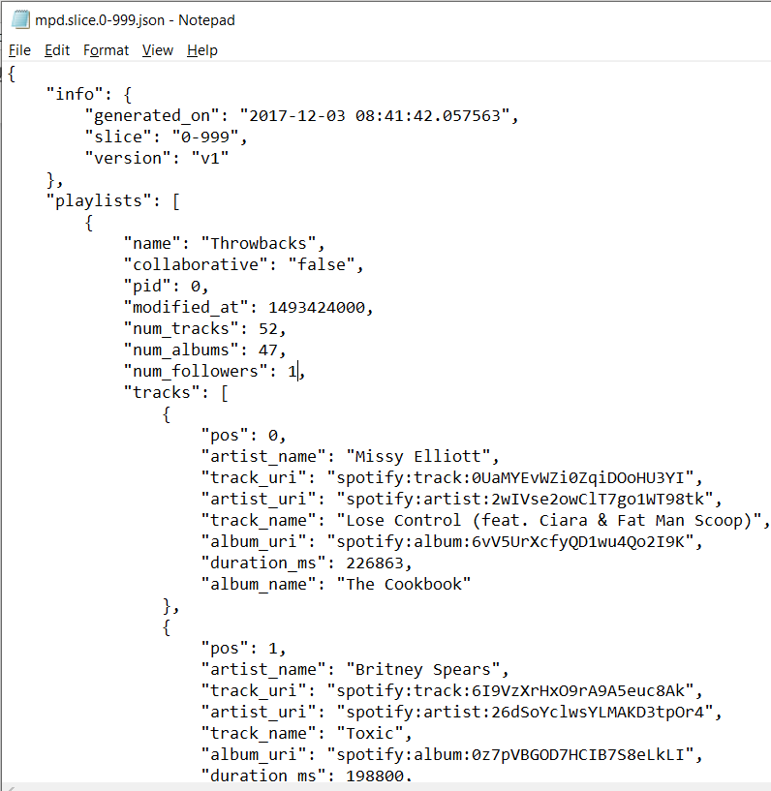
The Spotify Dataset- Extraction/Preparation
The data was extracted from Spotify using a developer account and Spotify API.
Once we get the developer credentials (client id, and secret), we can use those to authenticate the session and create a ‘Spotify’ object and extract playlists.
To the right are screenshots illustrating 1000 .json files, each containing 1000 playlists, and the format in which playlist and track information is stored inside each .json file.

Slide 5
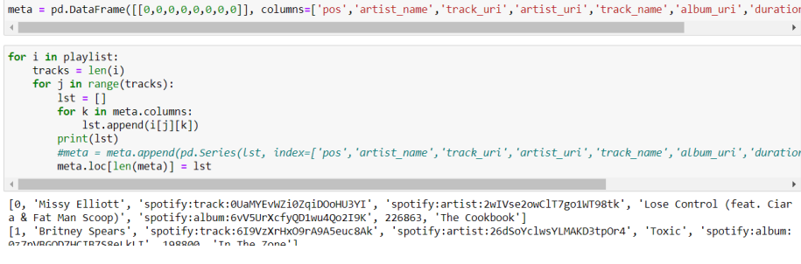
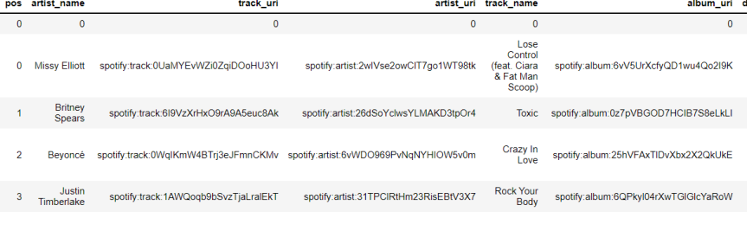
The Spotify Dataset- Extraction/Preparation
We extracted 1 Million playlists from Spotify using the API, with an average of 67 songs in each.
To avoid such a large scope of data, we consider 200,000 songs picked using bootstrap sampling from the total 1million playlists to work with.
We extracted the tracks and their meta data into a Data Frame using the following code.
The “Popularity Score” and “Genre” was extracted by retrieving the meta data of each track.

Slide 6

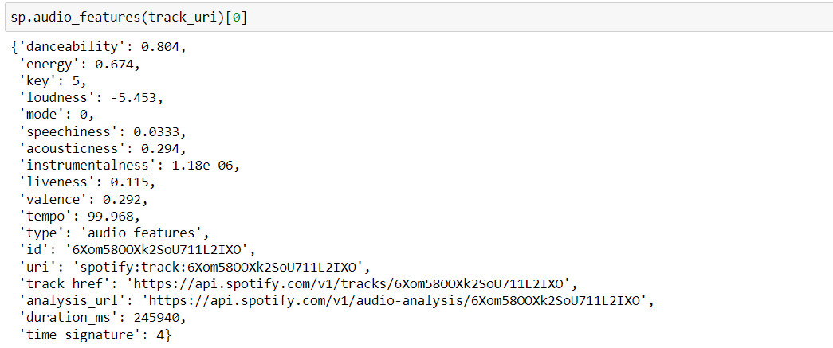
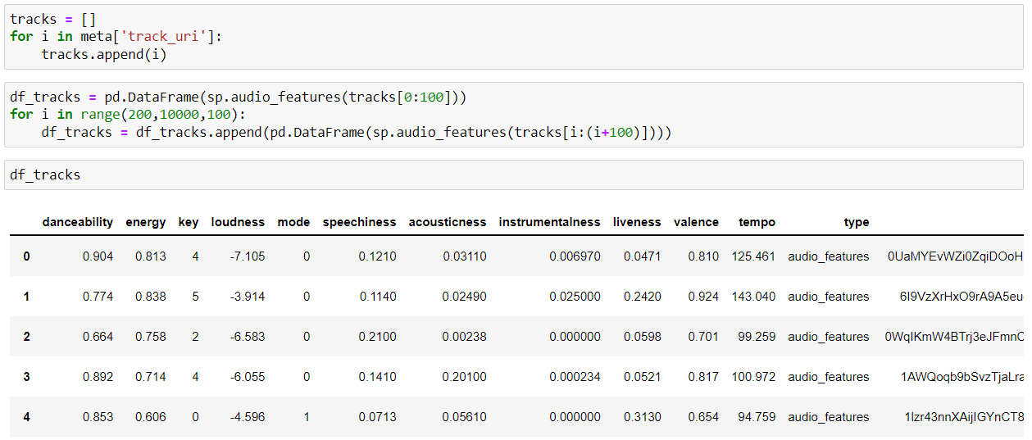
Once we obtained the meta data, we used the ‘Audio_Features’ function of the Spotipy Package to retrieve various track attributes such as ‘danceability’, ‘energy’, ‘acousticness’, ‘valence’, ‘tempo’, etc. and store those values into our final data frame on which we will perform our analysis.
Below is the code used to generate the dataset, and a snippet of the resulting data frame:
Now that we have a relevant Data Frame to analyze, we are ready to move on to the next step of Exploratory Data Analysis.

Slide 7
Data Description and Techniques Used
Data Description
The working dataset has 200,000 rows which we selected using bootstrap sampling from 1million extracted playlist.
The dataset has 23 columns, most of them being numerical with just 2 categorical variables of interest - ‘genre’ and ‘time_signature’.
We dropped the unnecessary columns such as track_id, audio_features etc. during EDA.
For trend analysis we’ll use the ‘popularity’ score as a target variable, and for sentiment analysis and recommendation system we use the other attributes such as ‘speechiness’, ‘valence’, etc.
Techniques Used
Spotipy package was used to extract song metadata from global Spotify playlists.
In-built functions from Spotipy package was used to generate the dataset with 200,000 songs using bootstrap sampling.
We’ll be using matplotlib and seaborn packages to illustrate our analysis during EDA.
Inferences will be drawn from EDA which will aid in building and selecting ML models.
Clustering (with PCA) and a content-based Recommendation system will be developed

Slide 8
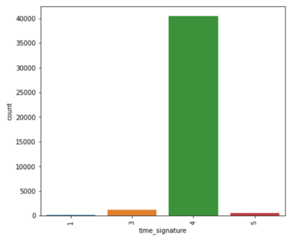
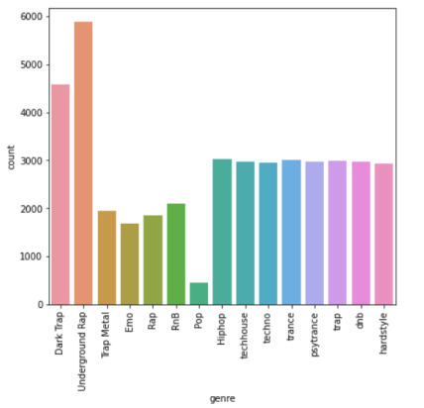
EDA- Categorical Variables
Since there are only 2 categorical columns of interest, we start with countplots for “genre” and “time_signature”.
Inferences:
Time_signature 4 dominates our dataset, more than 90% of tracks out of the 200,000 has a time_signature of 4. This means people are generally more receptive towards songs with certain beats per minute which qualifies as time_signature: 4.
Rap and Trap songs contribute the most to our selected song list, while pop has the least count among all other major genres.
Genres like Hiphop, Techno, Freestyle, Trance have around the same number of instances, and hence are equally popular.

Slide 9

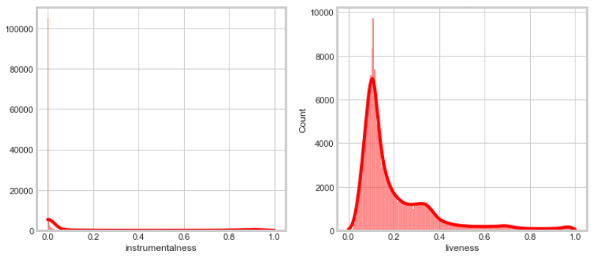
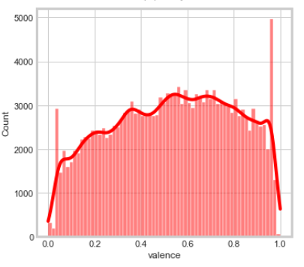
EDA- Numerical Variables
Instrumentality and liveliness are heavily right skewed and have a positive bias, we can keep this in mind when building our recommendation engine.
Valence shows a steady decrease in count as with respect to its value, this again is an interesting observation for our recommendation system. Most songs in the top charts have a valence from 0-0.5, which illustrates that neutral or negative emotions actually have a higher staying power, while the positive ones are short lived in people’s minds.

Slide 10
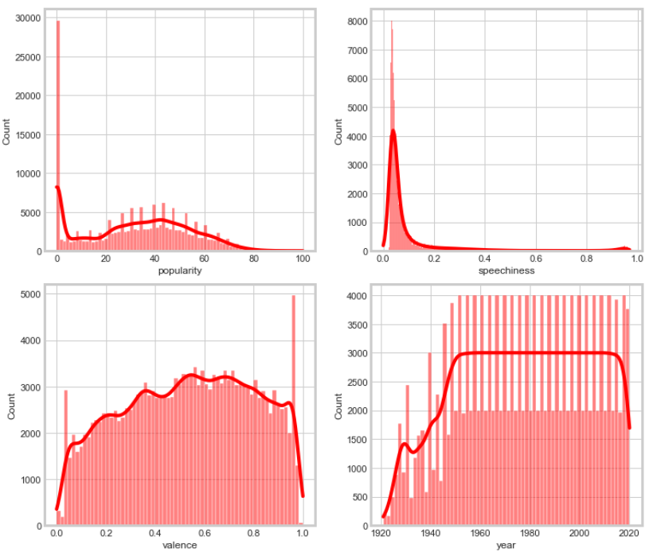
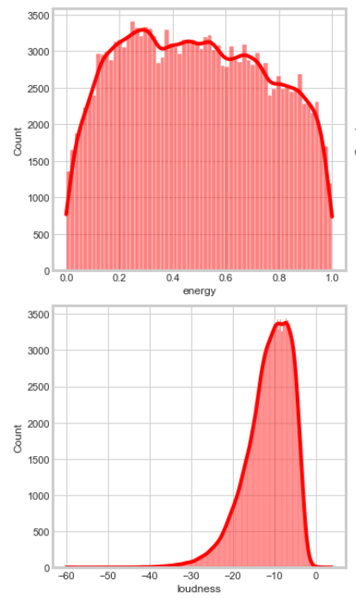
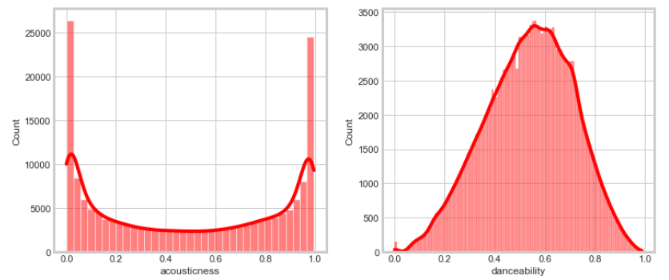
We can also observe that loudness, danceability and tempo are somewhat close to a normal distribution, this also means that the average dominates in these attributes.

Slide 11
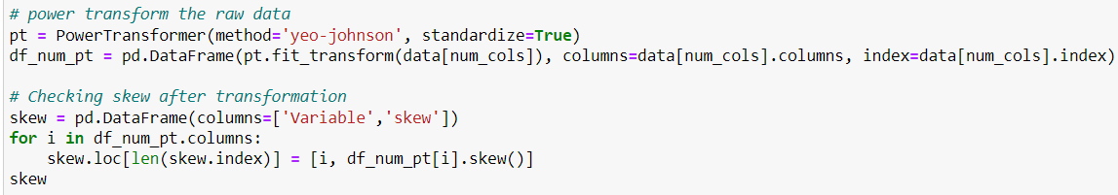
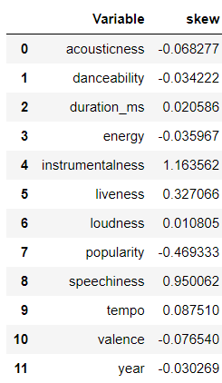
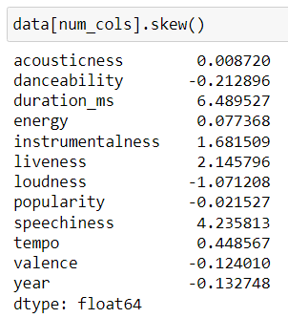
Checking the variables for Skew and observing new values after power transformation
Performing Power Transformation
Initial Skew
As we can observe from the images, the skew values improve upon performing the power transformation. This will improve model performance and help us achieve better accuracy.
Skew post Power Transformation

Slide 12

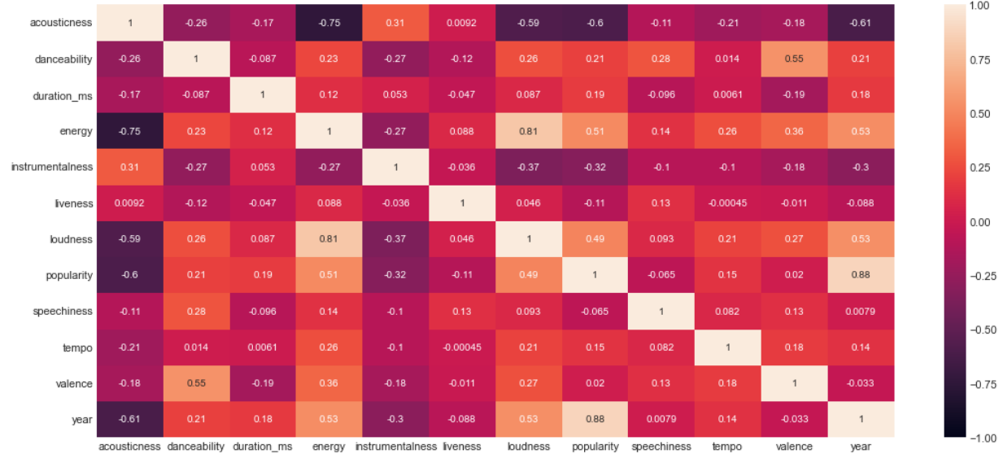
Checking for Multicollinearity
There is no visible evidence of high multicollinearity on the Heat Map.

Slide 13
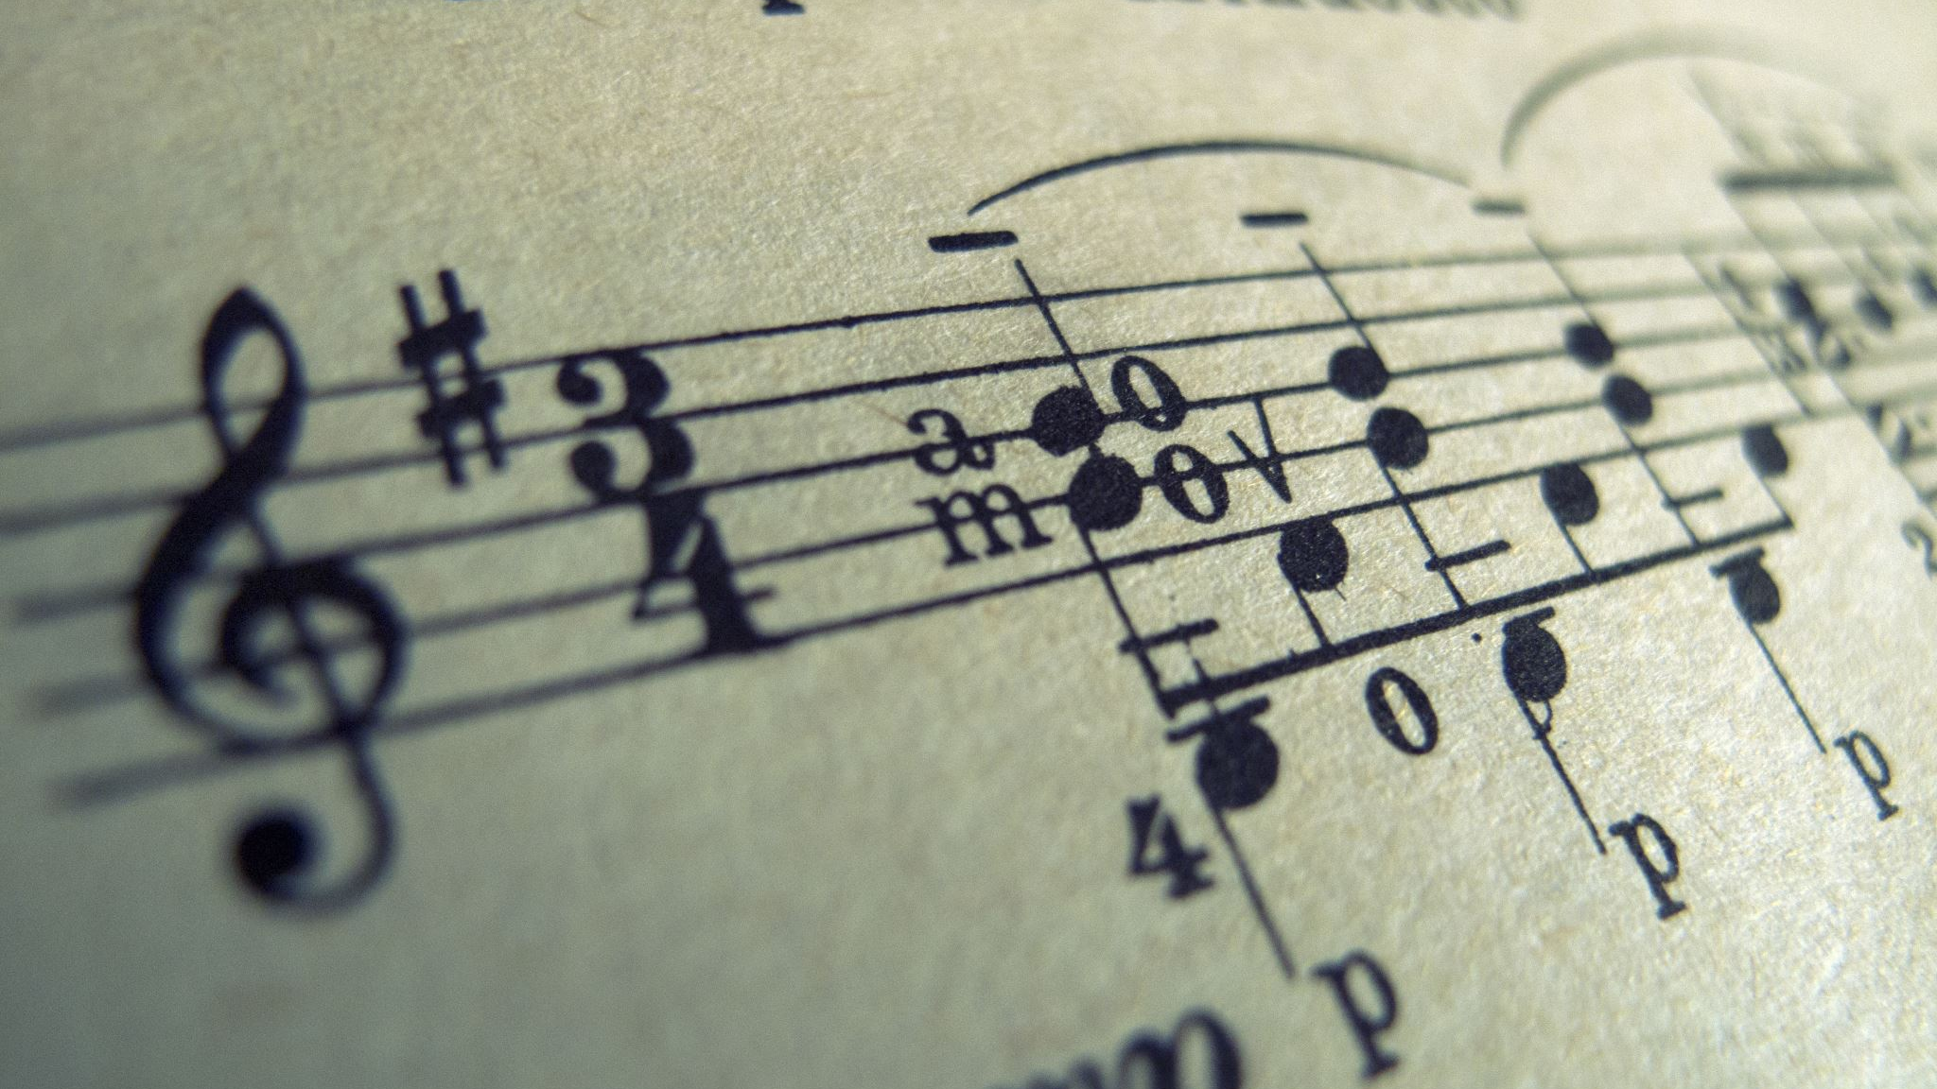
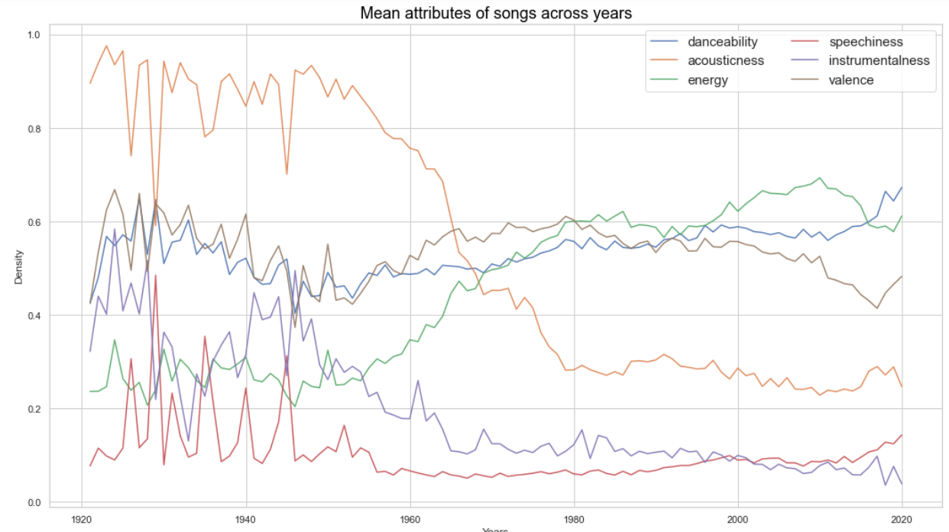
As we can observe from the image, there has been a shift in trends of various attributes associated with songs over the years.
In the 1900’s, Acousticness and Instrumentalness had the highest density, but has declined sharply around the 1960s.
Attributes such as Danceability and Energy have improved.
Attributes like Valence remain more or less constant, with no major hikes or falls.

Slide 14
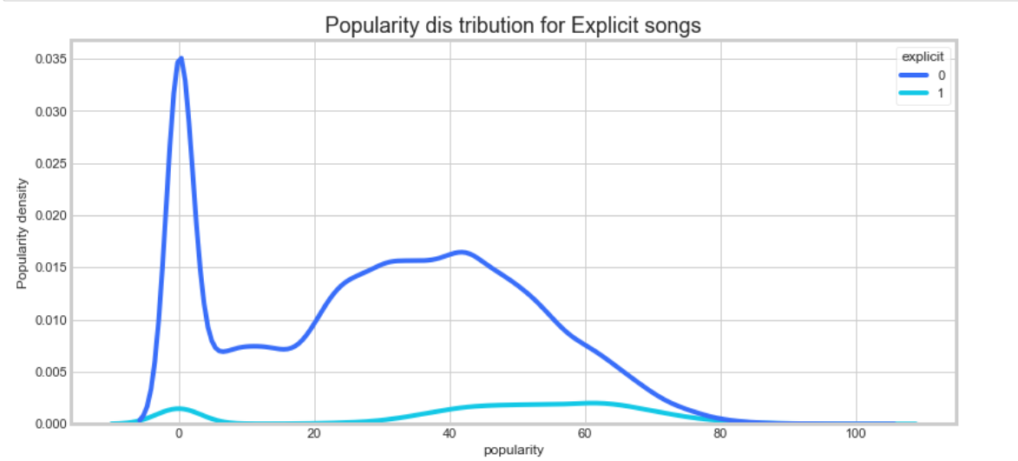
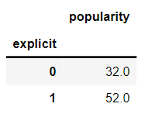
As we can observe from the graph and the table, songs that are explicit tend to be more popular than songs that aren’t explicit.
Hence, the feature “Explicit” plays an important role in predicting the popularity of a track.
Now that EDA and visualizations are complete, we are ready to move on to Model Building.

Slide 15
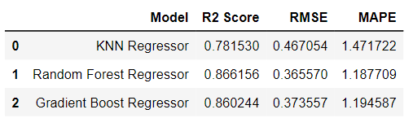
Model Building- Popularity Prediction (Supervised Learning)
After performing Scaling, transformations and train/test split, we are ready to build our models.
We built three models:
KNN Regressor
Random Forest Regressor
Gradient Boost Regressor
Outputs of relevant metrics from the models.
In order to select the best model that accurately predicts the population of a song, we need to select one which has a high R2 Score and low RMSW and MAPE scores.
As seen from the output displayed, the Random Forest Regressor Model has the ideal R2, RMSE and MAPE scores. Hence, we can conclude that it is the best model for predicting the popularity of a song based for our dataset.

Slide 16
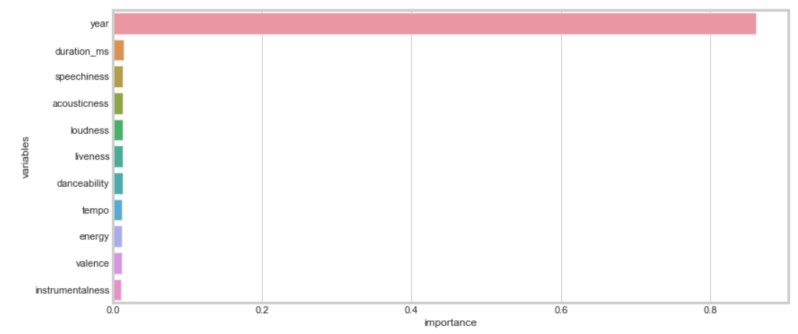
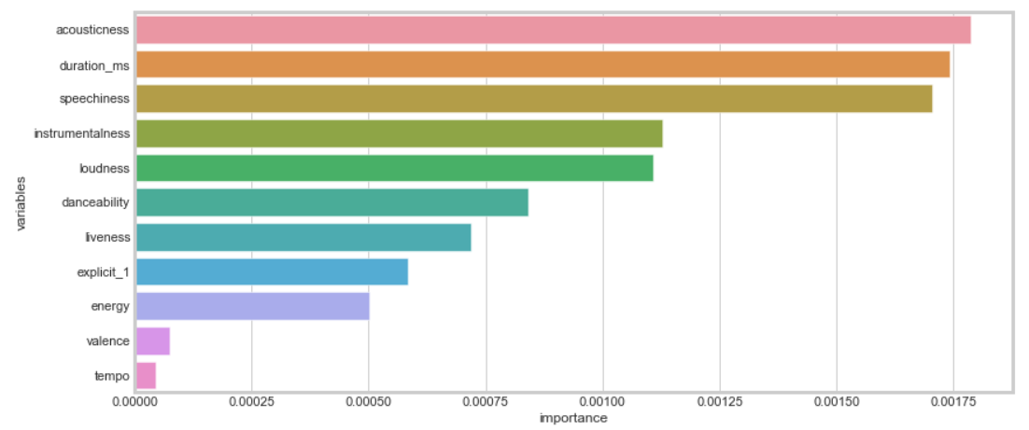
Important Features
As suspected ‘Year’ of release has a high impact on the song’s popularity.
The next most important features determining a song’s popularity are shown in the below visualization

Slide 17
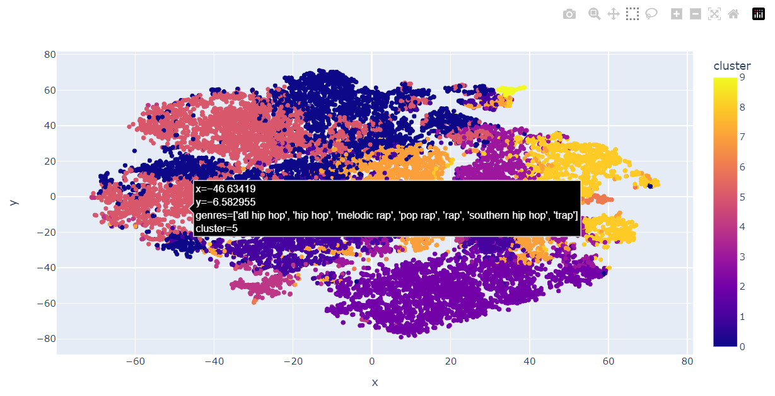
Clustering Using K-Means (Unsupervised Learning)
Clustering sub-genres into 9 main categories of Genre
(hip hop, rock, indie, jazz, classical/opera, house, etc.)

Slide 18
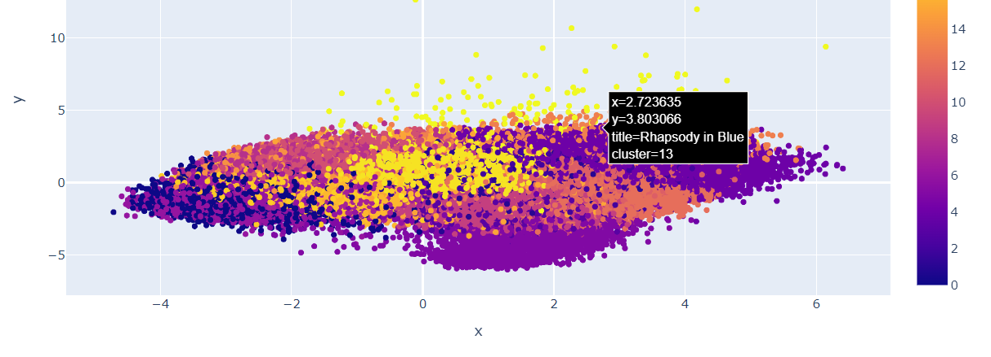
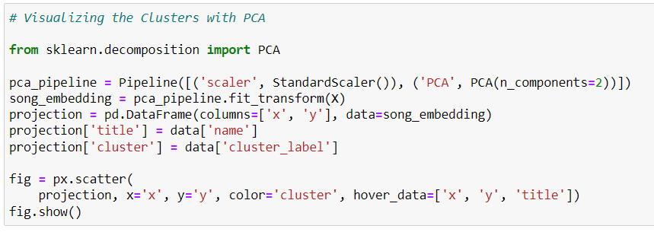
C
Clustering of Songs based on Attributes
(after dimension reduction using PCA)

Slide 19

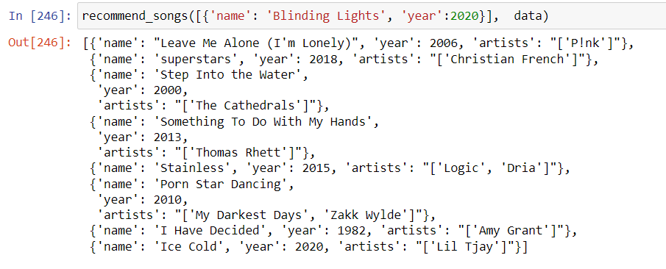
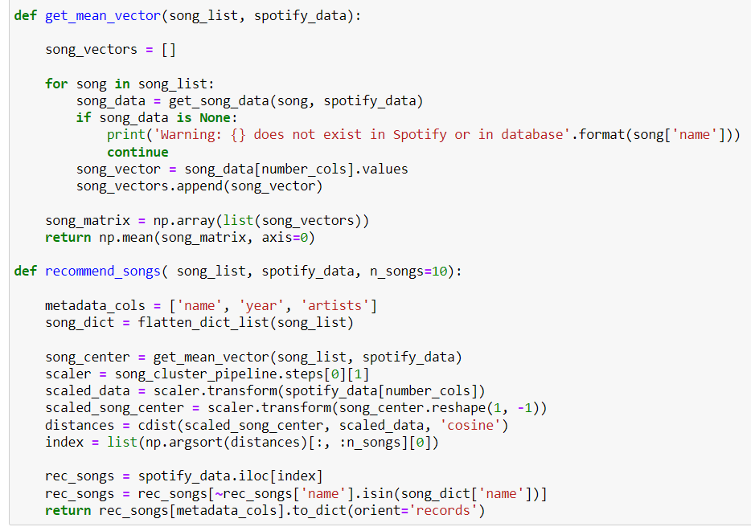
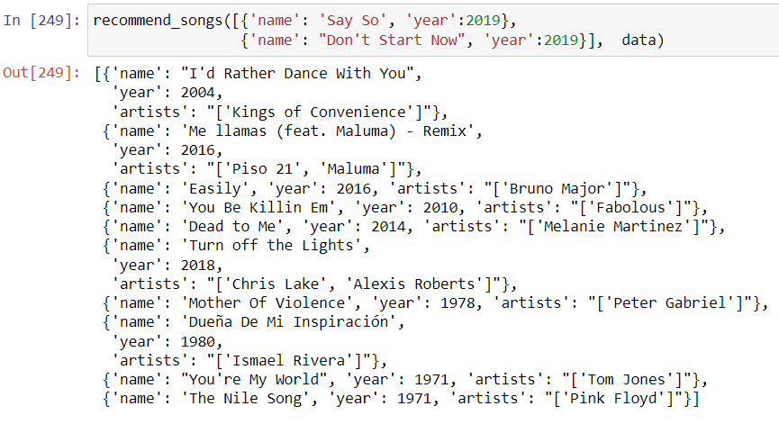
Recommendation System (Hybrid)
We created two user-defined functions to get the closest matching song in order to build the recommendation system.
The system takes as input the name of a song and its year. Based on the input, the system recommends songs that is a good match to the inputted song with respect to the Song’s attributes and popularity score.
The system is also capable of receiving multiple inputs to predict comprehensive matches.

Slide 20


